Slide 1
Module-3 Performance of Three-Phase Induction Motor:
Phasor Diagram Of Induction Motor on No-load and on Load,
Equivalent Circuit, Losses, Efficiency,
No-load and Blocked Rotor Tests.
Performance of the Motor From The Circle Diagram and Equivalent Circuit.
Cogging and Crawling.
High Torque Rotors-double Cage and Deep Rotor Bars.
Equivalent Circuit and Performance Evaluation of Double Cage Induction Motor.
Induction Motor Working as Induction Generator.

Slide 2
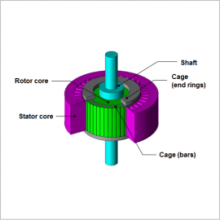

Slide 3
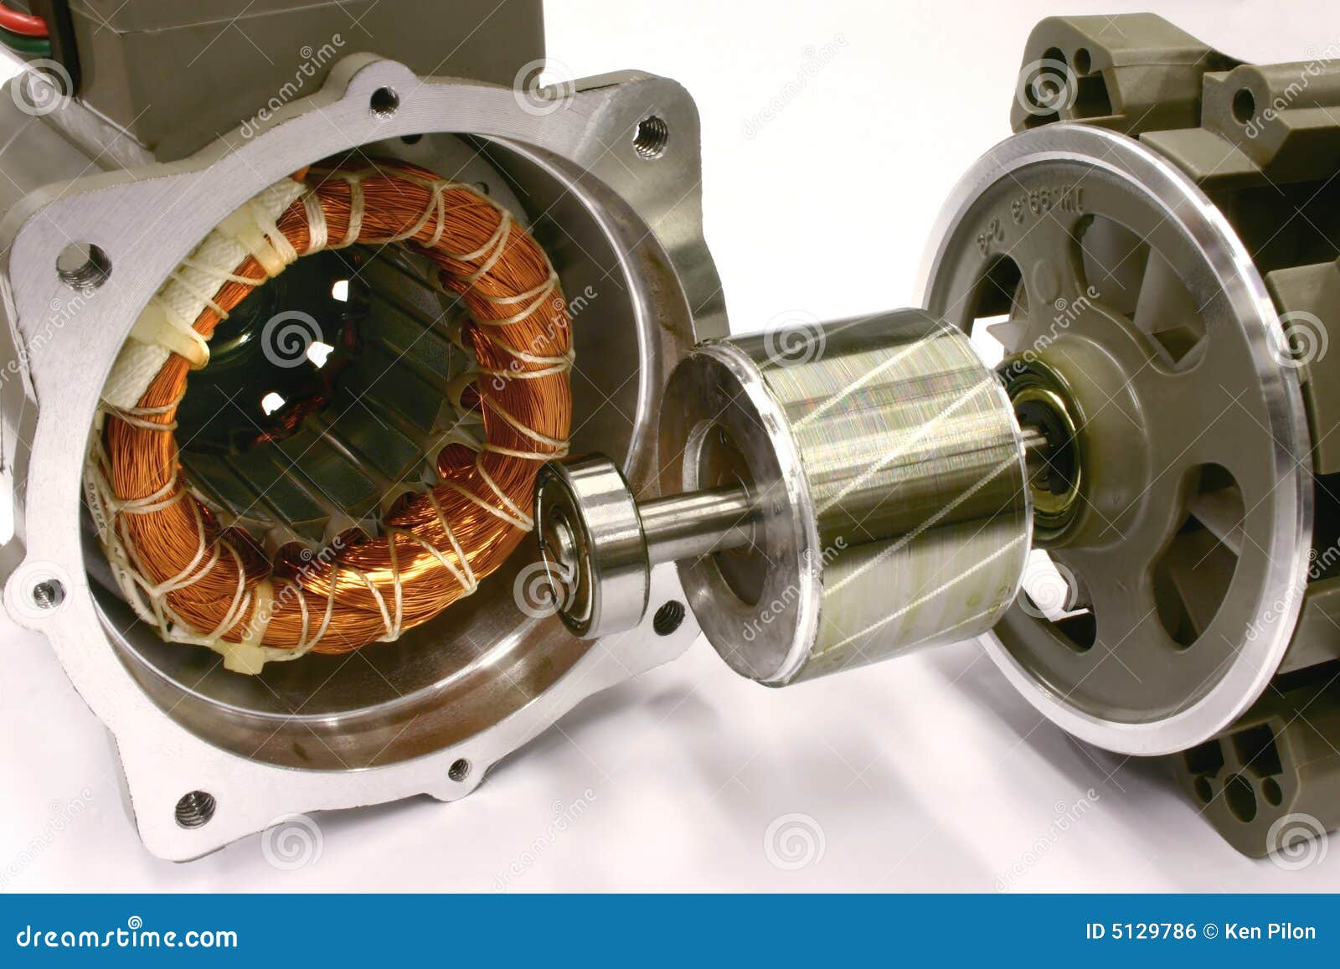

Slide 4
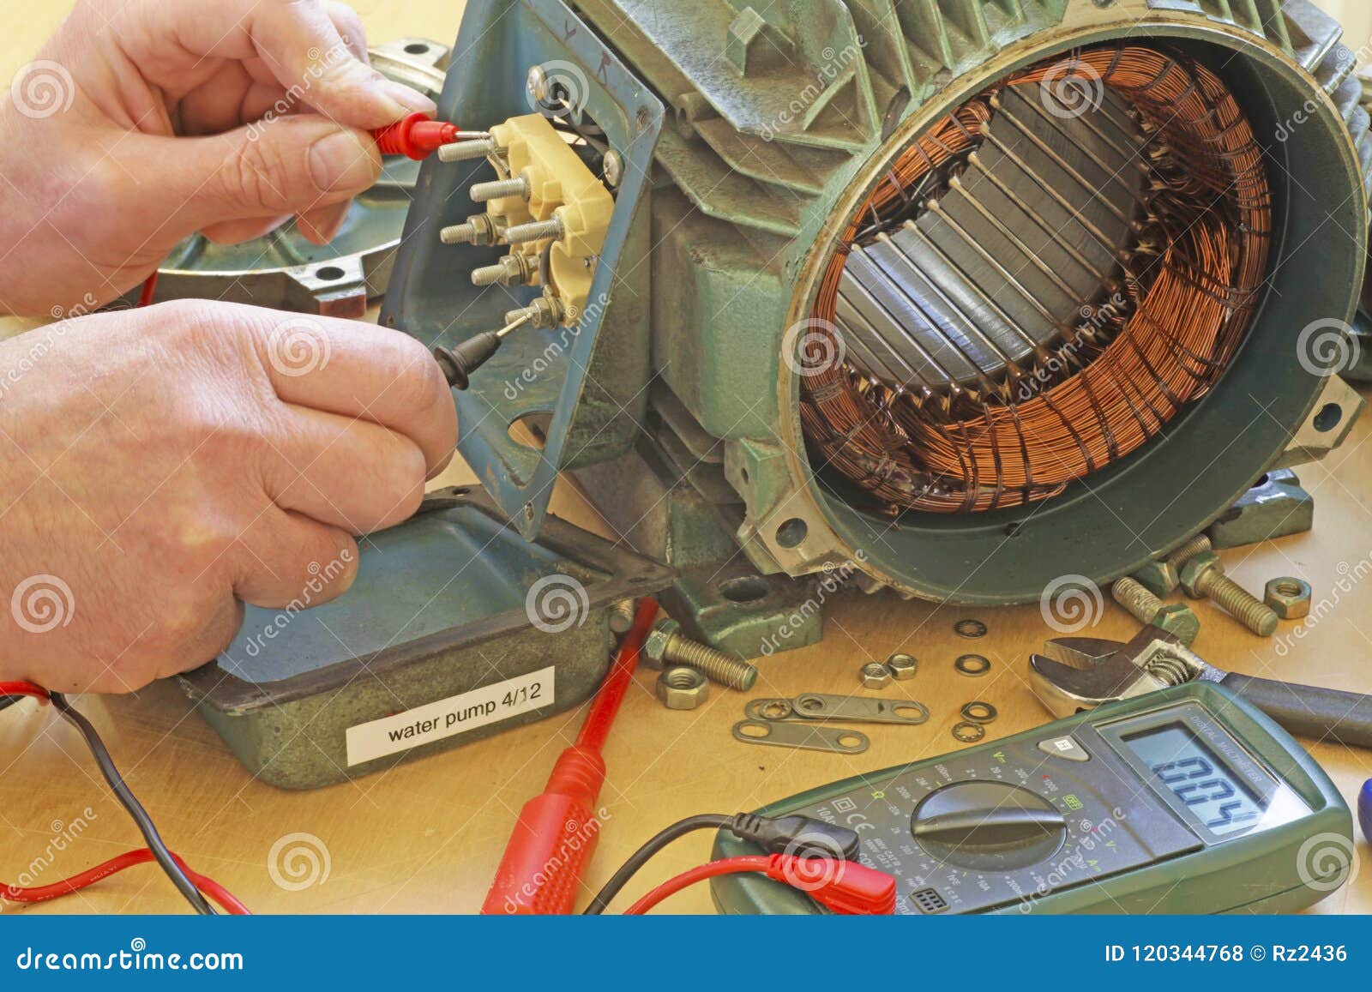

Slide 5
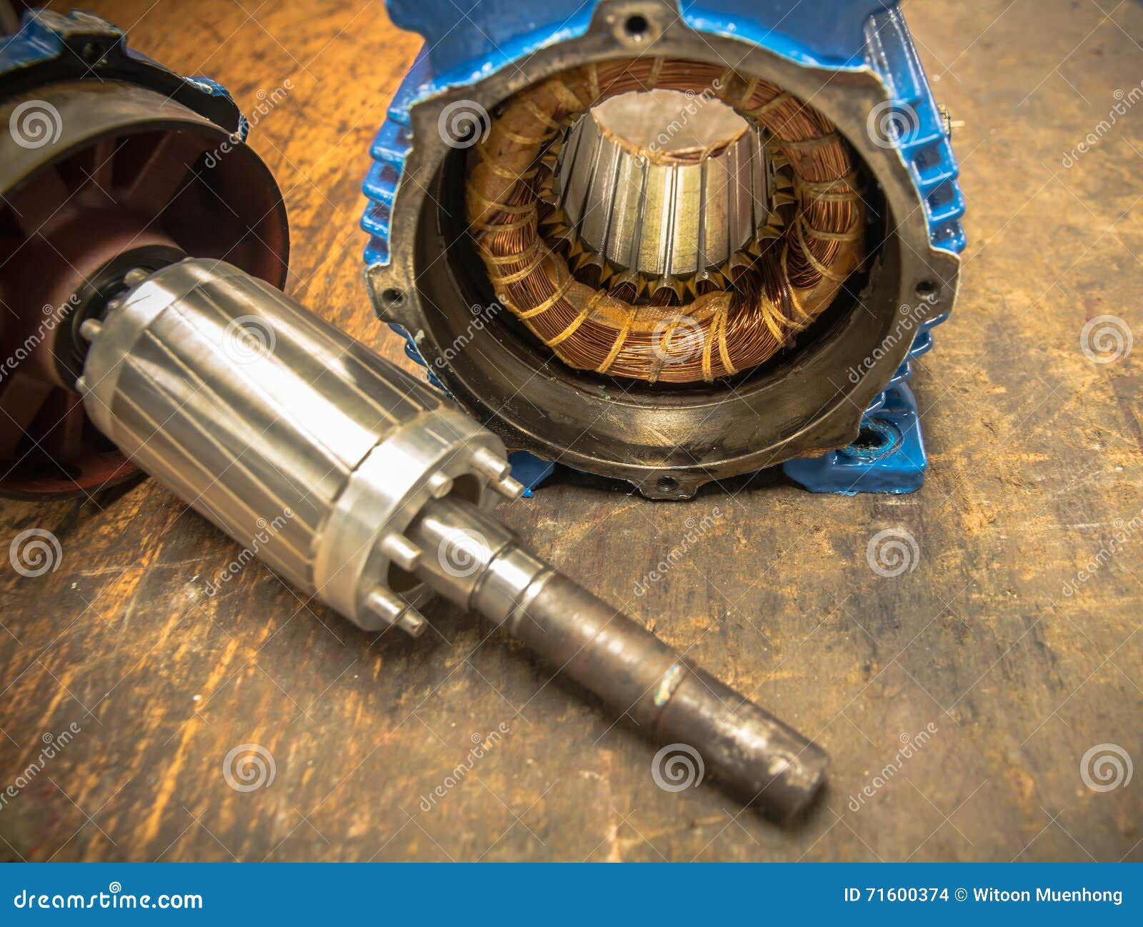

Slide 6
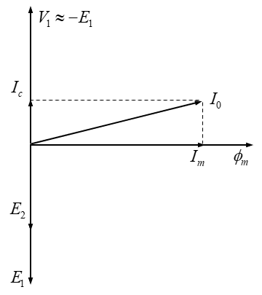
Phasor Diagram Of Induction Motor on No-load and on Load,
V1 = E1-I0Z0
Ic = Io Cosøo
Im = Io Sinøo

Slide 7
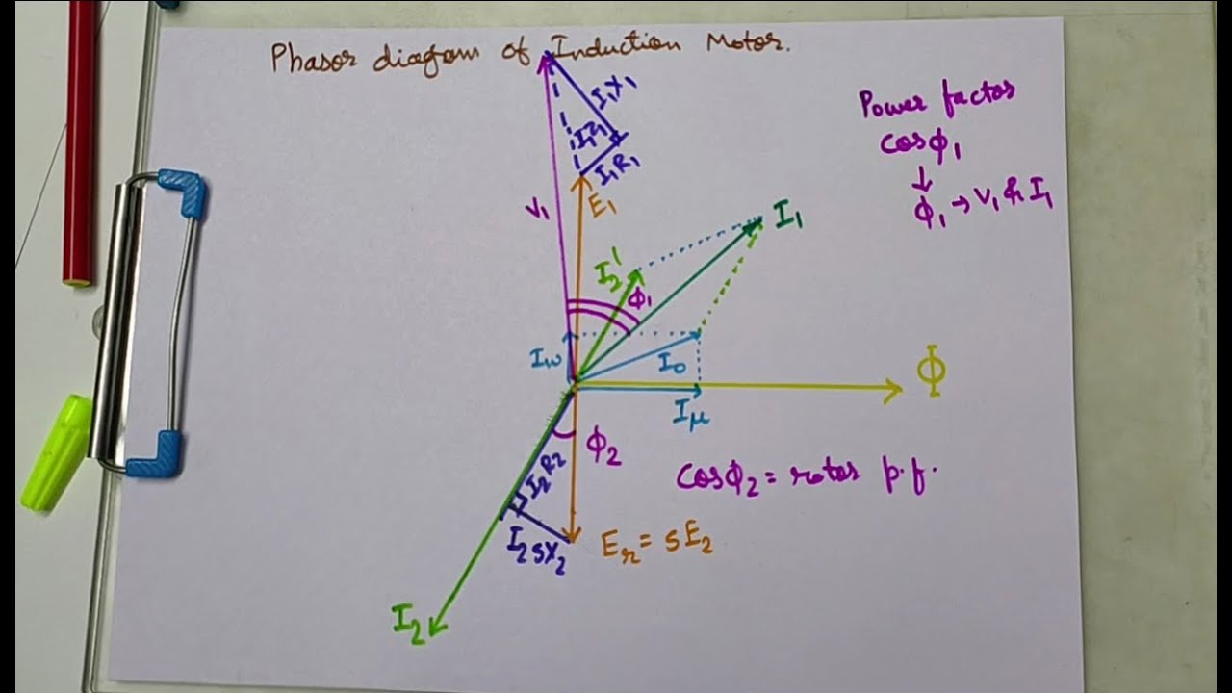
V1 = E1-I1Z1
V2 = E2-I2Z2

Slide 8
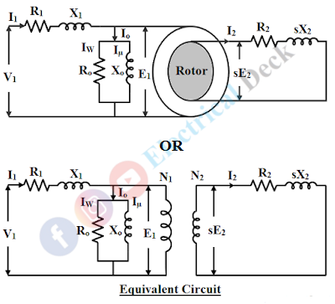
Equivalent circuit of 3phase induction motor

Slide 9
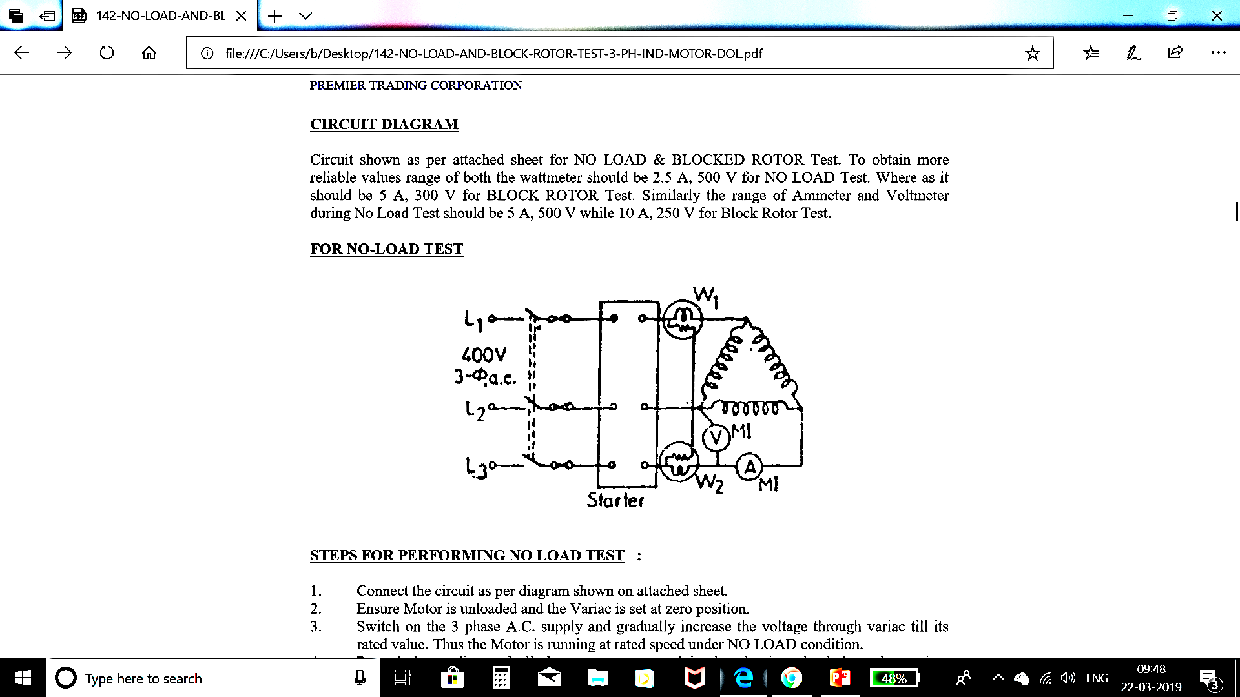

Slide 10
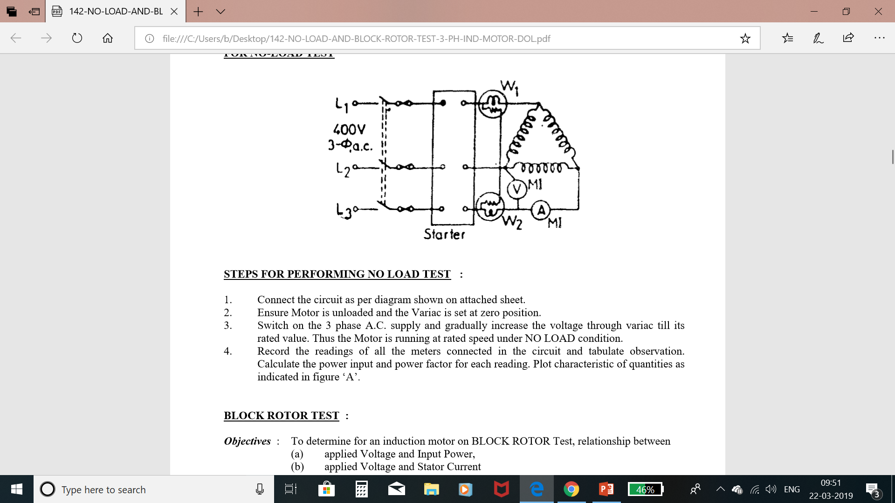

Slide 11
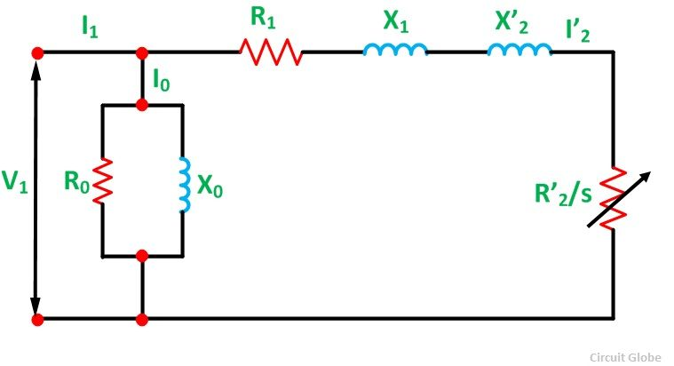

Slide 12
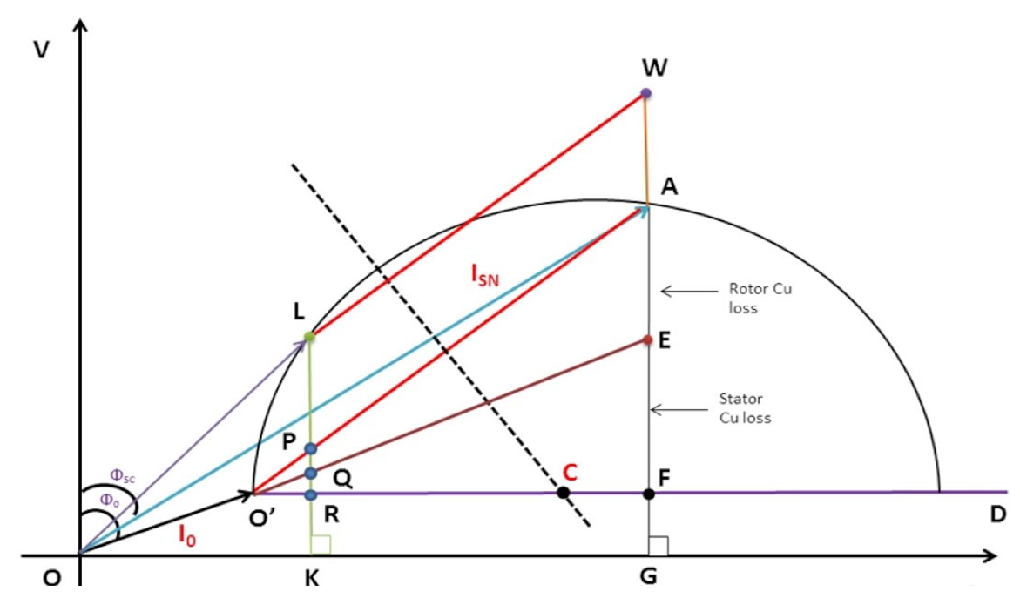

Slide 13
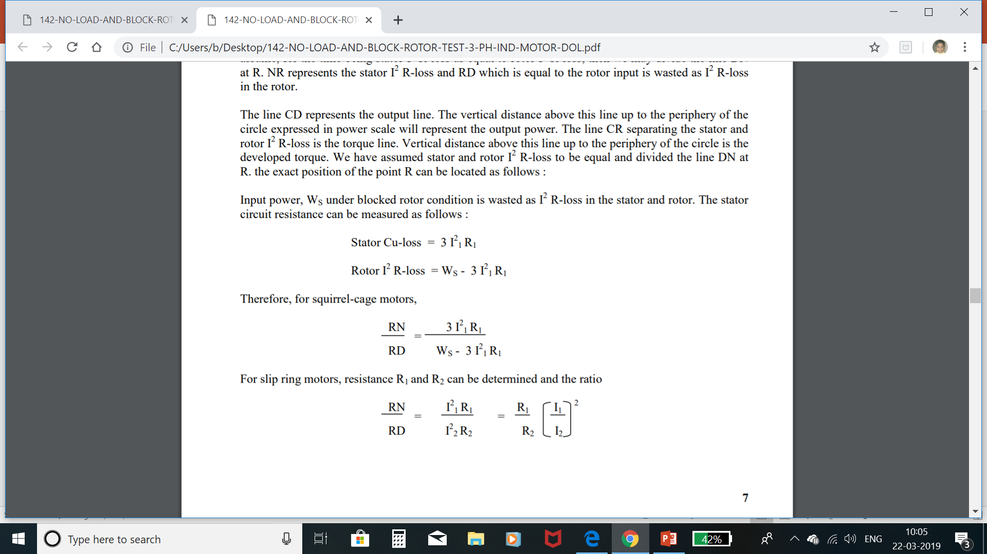

Slide 14
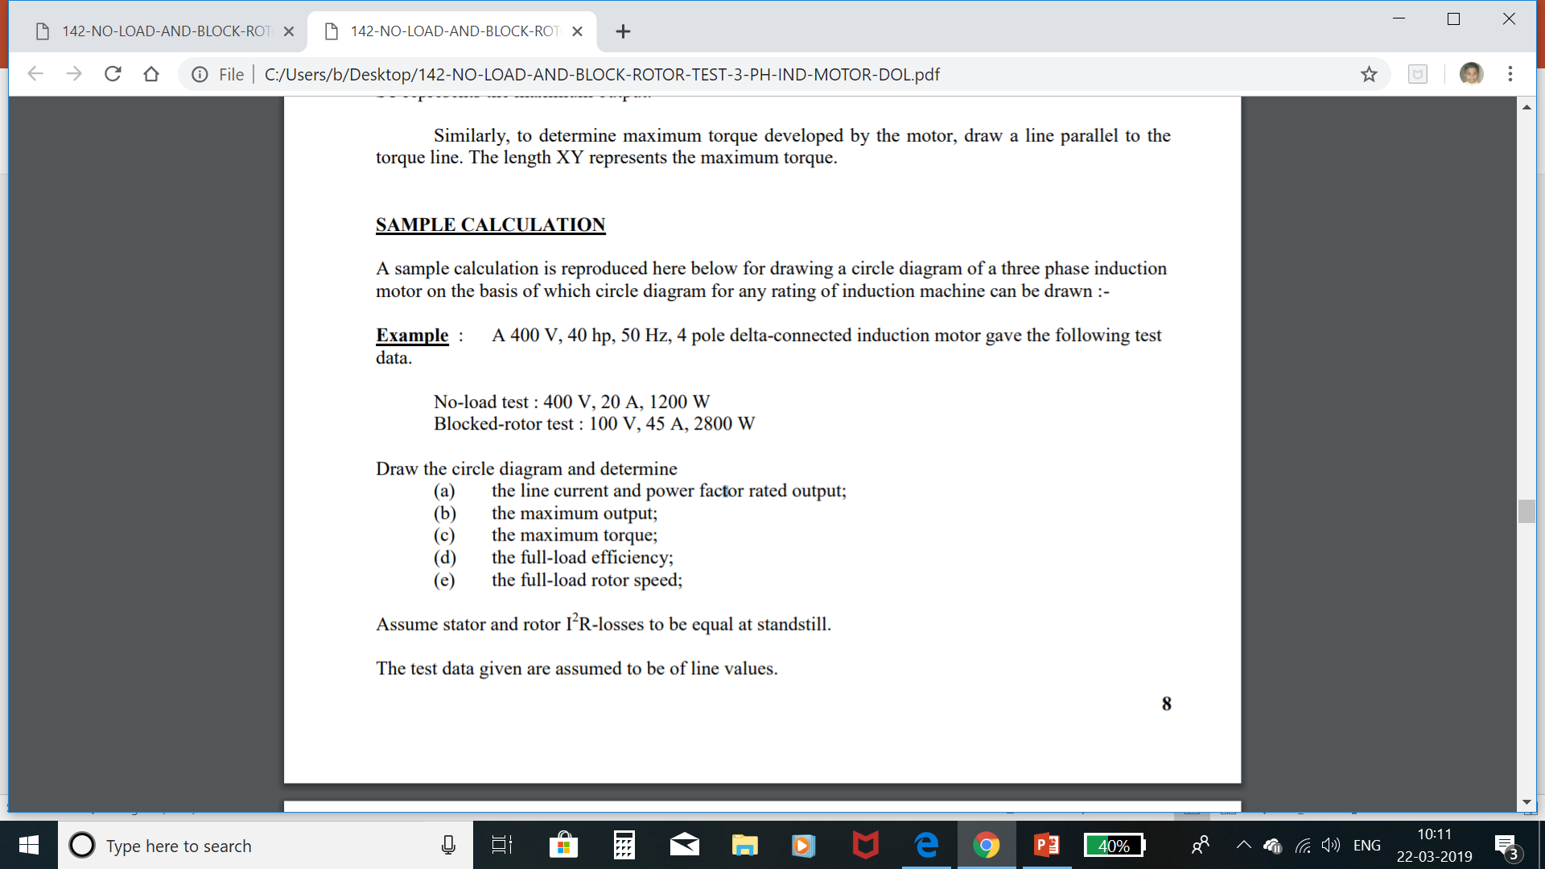

Slide 15
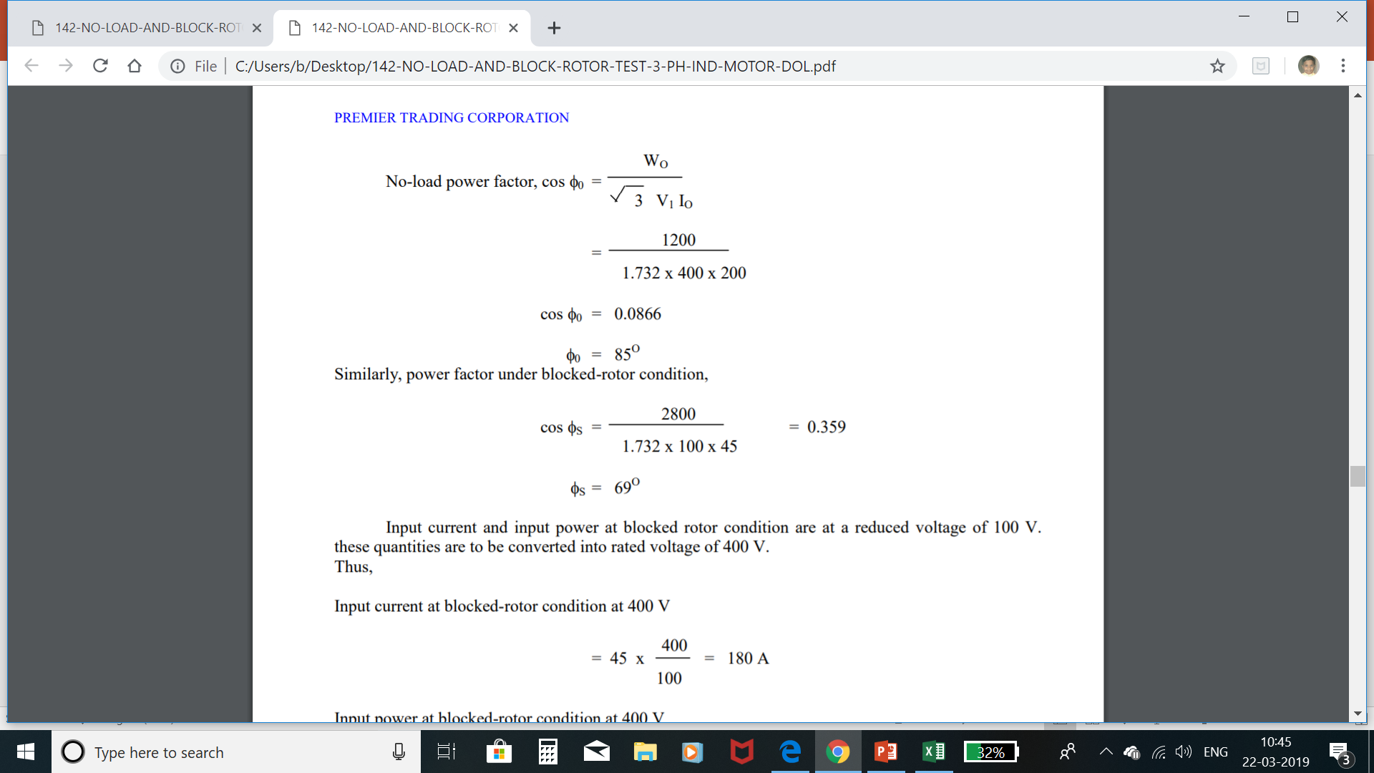

Slide 16
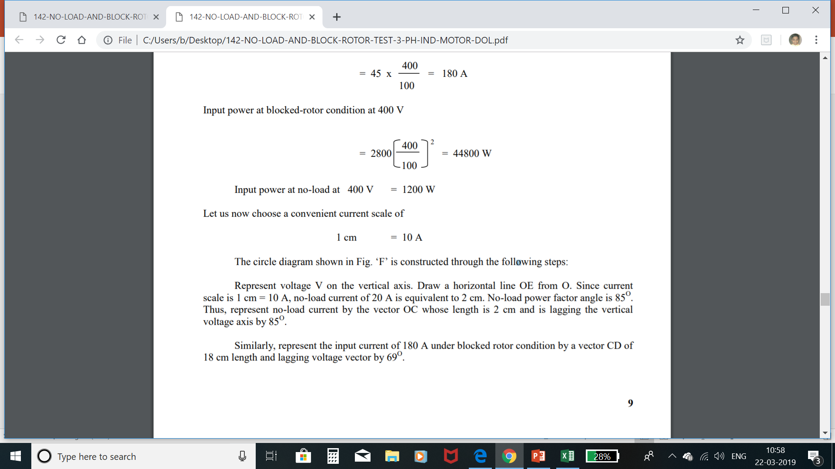

Slide 17
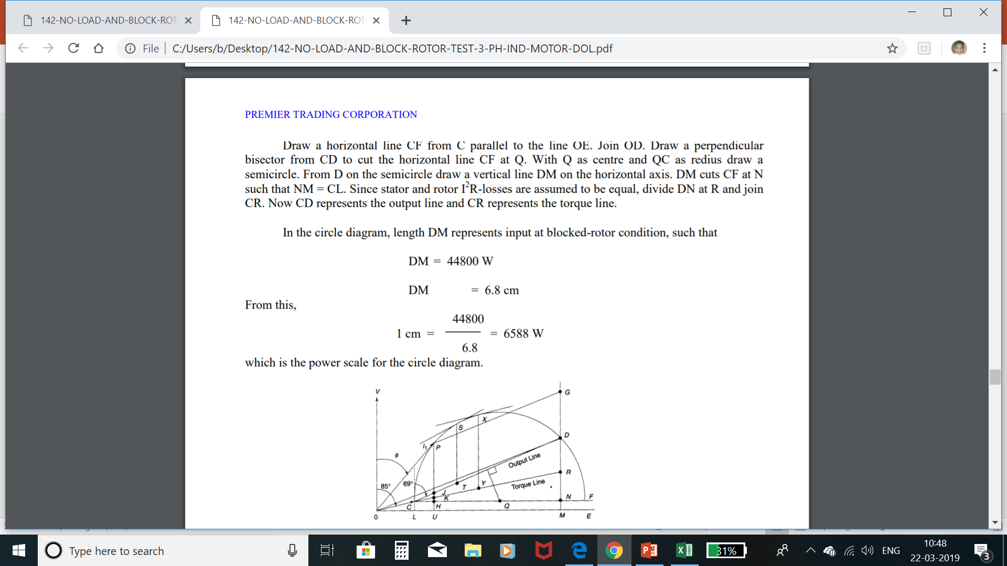

Slide 18
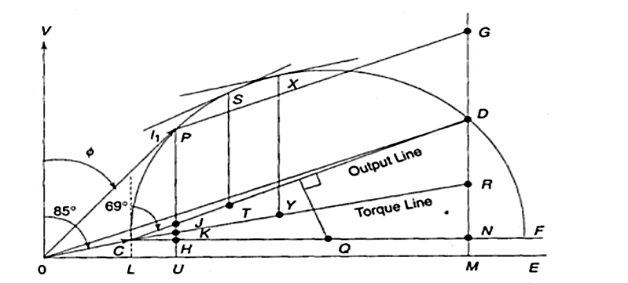

Slide 19


Slide 20
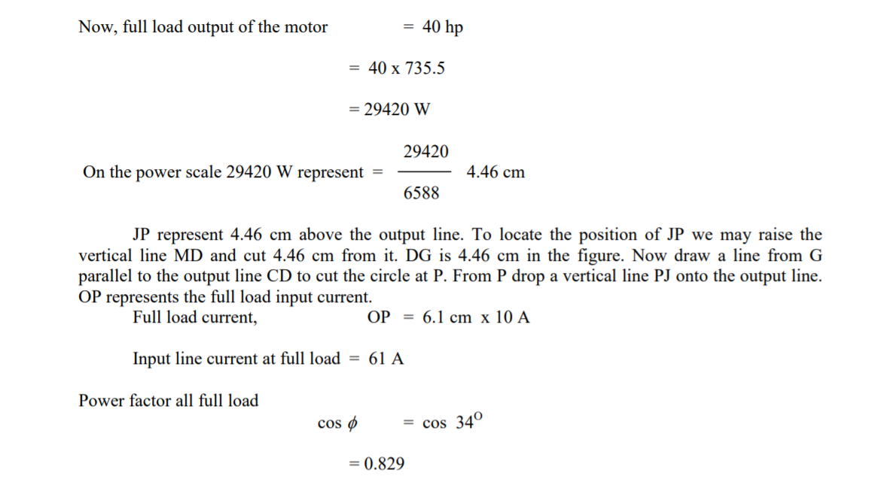

Slide 21
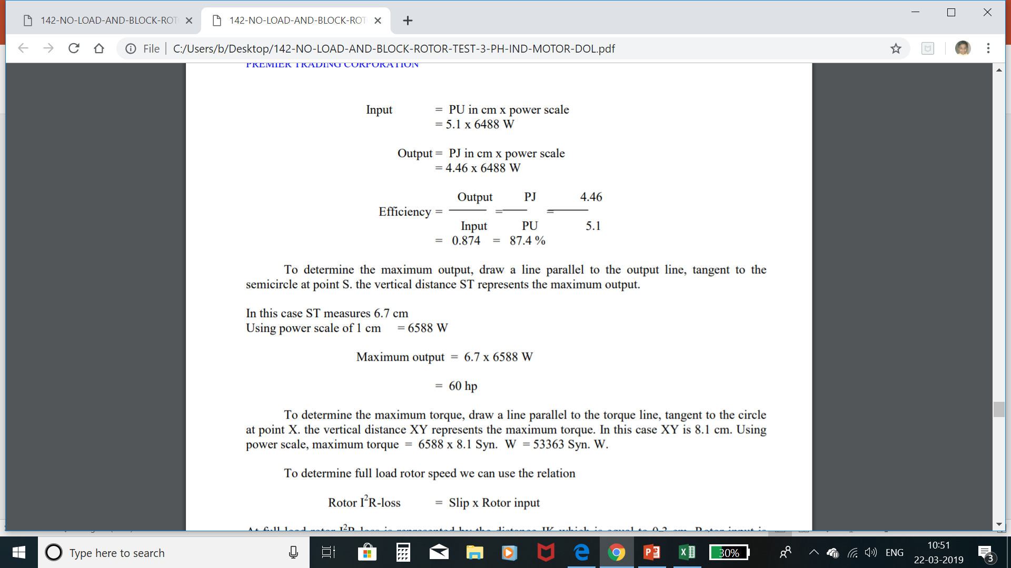

Slide 22
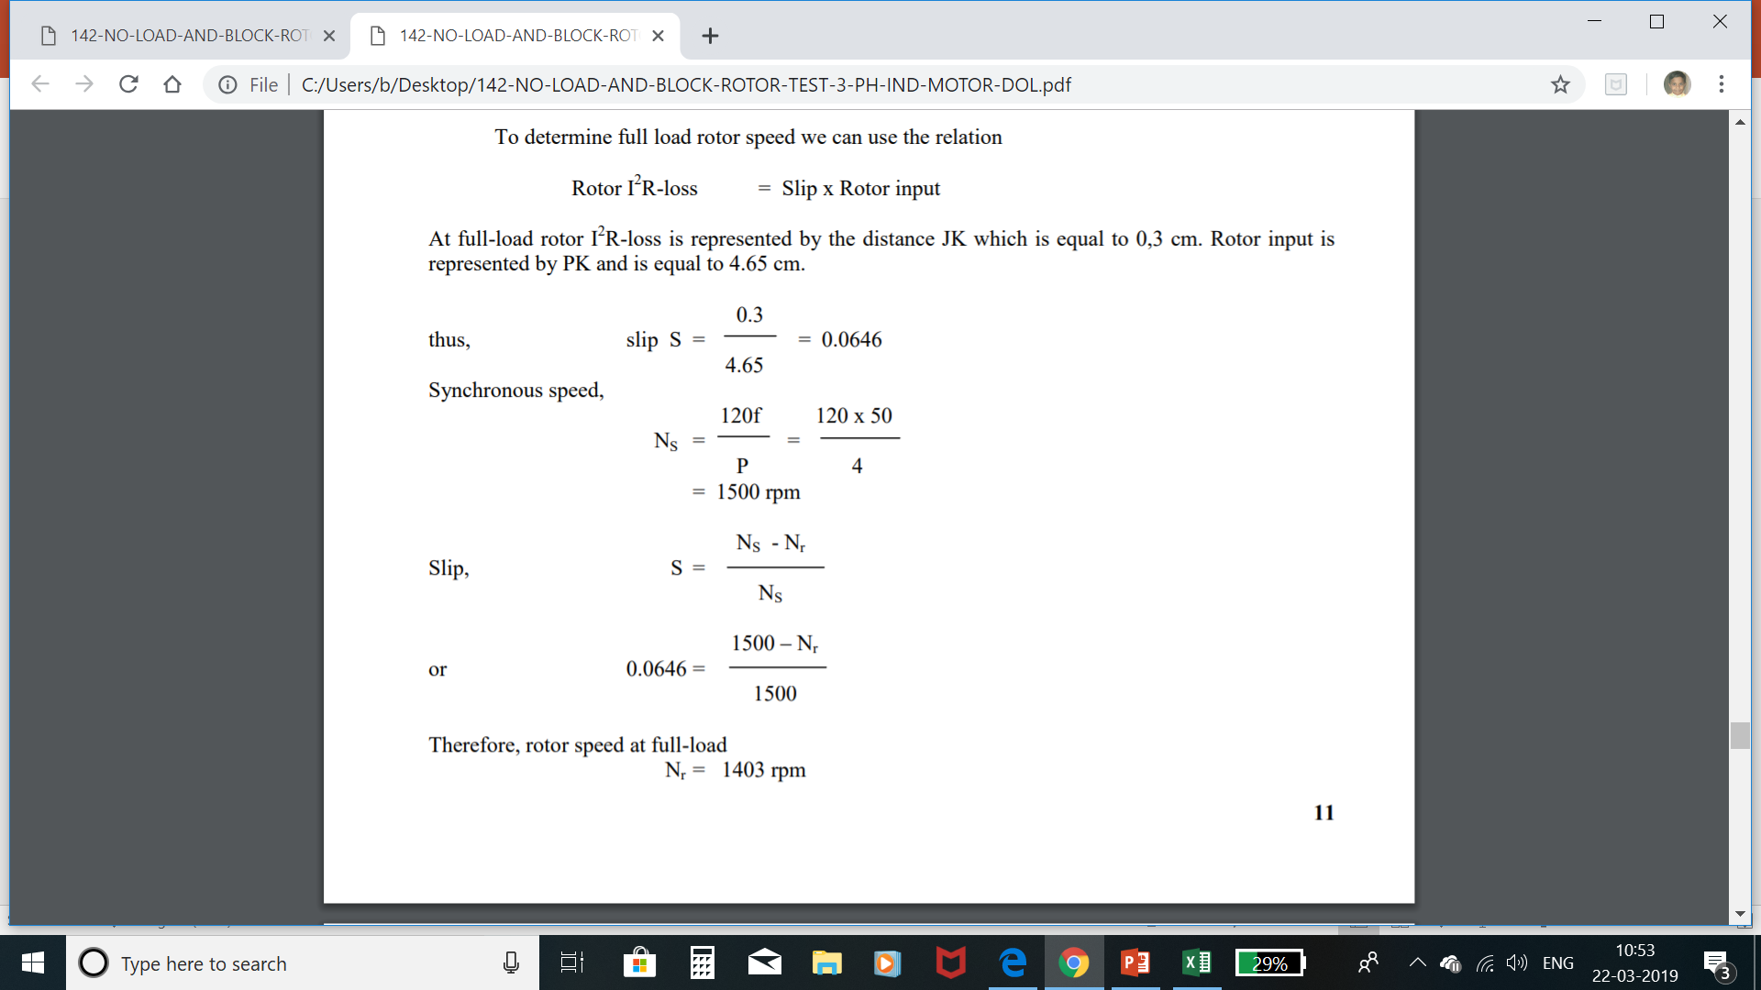

Slide 23
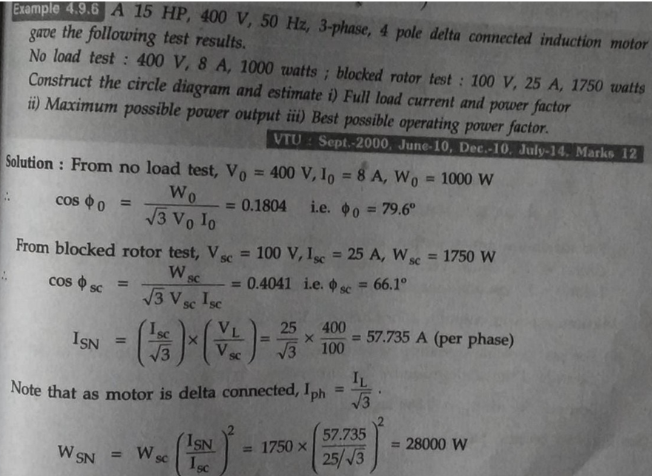

Slide 24
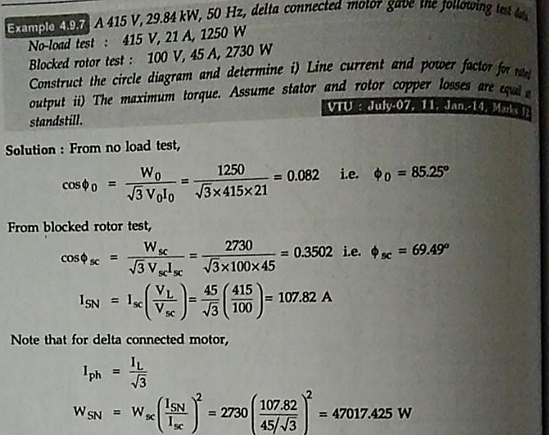

Slide 25
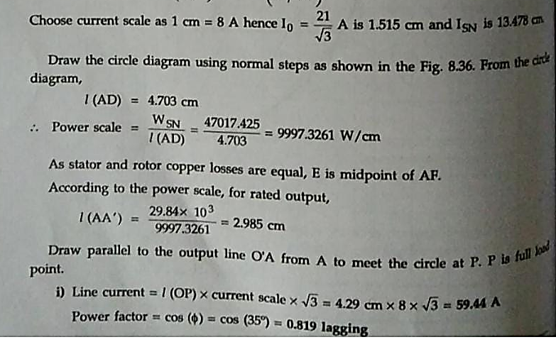

Slide 26
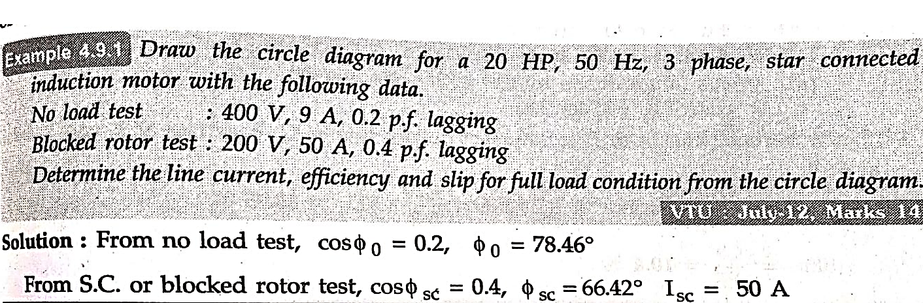
Problems on circle diagram

Slide 27
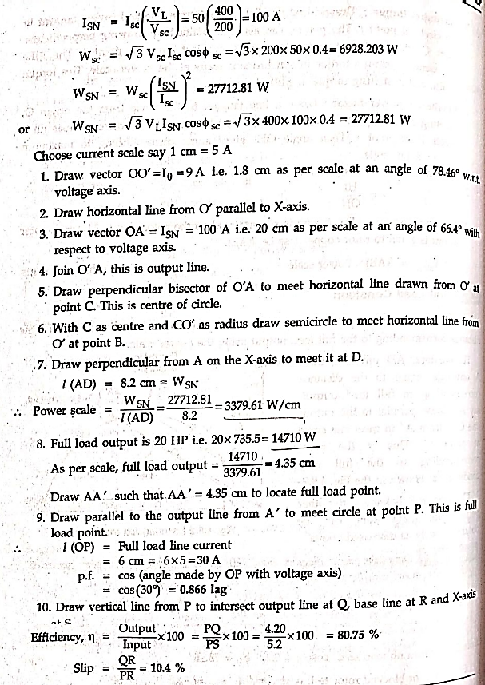

Slide 28
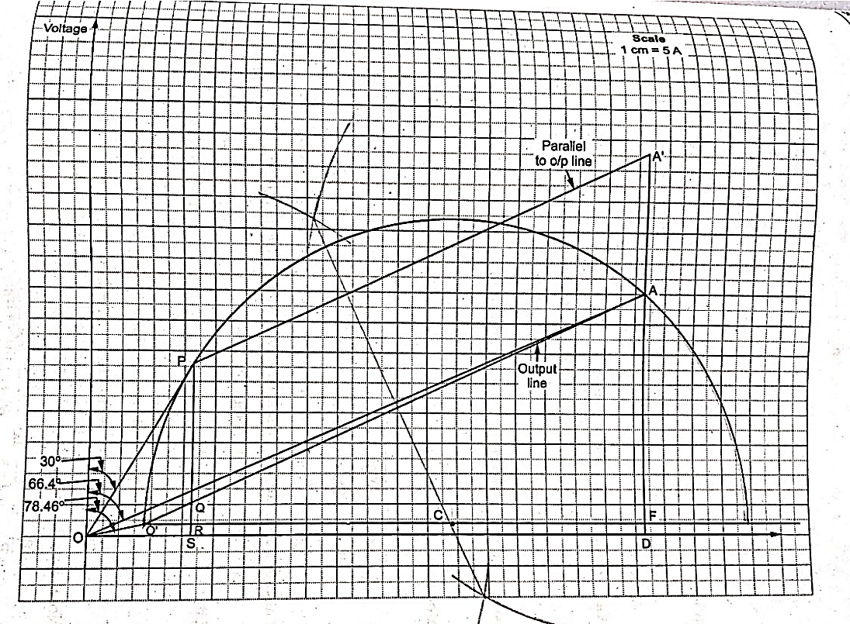

Slide 29
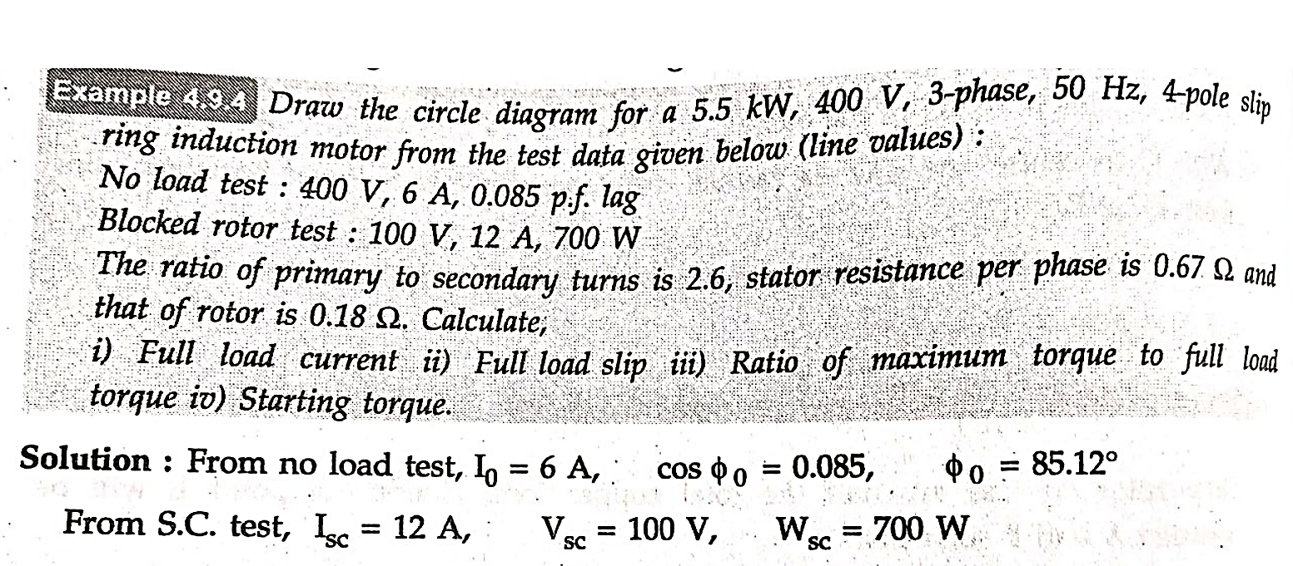

Slide 30
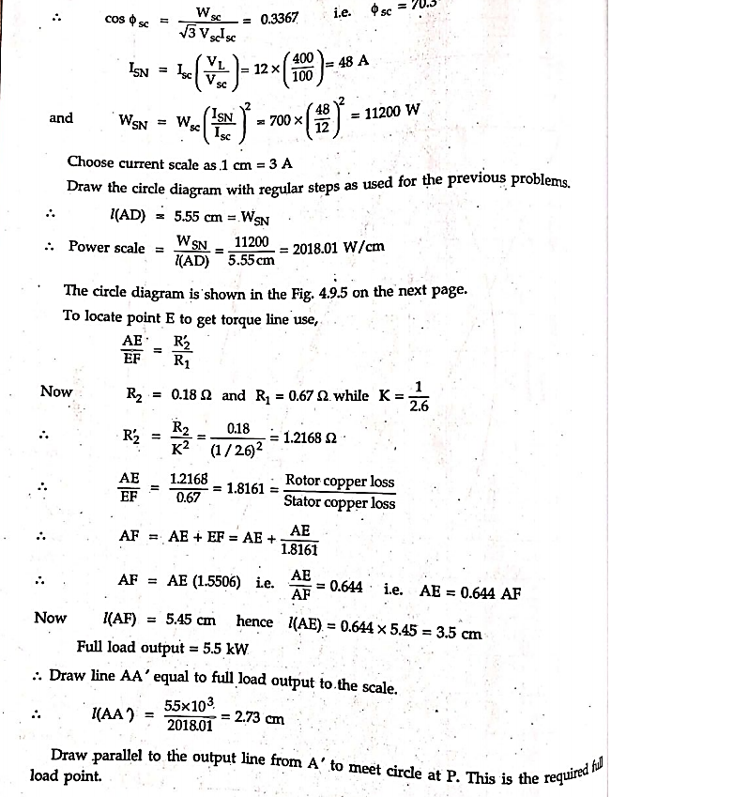

Slide 31
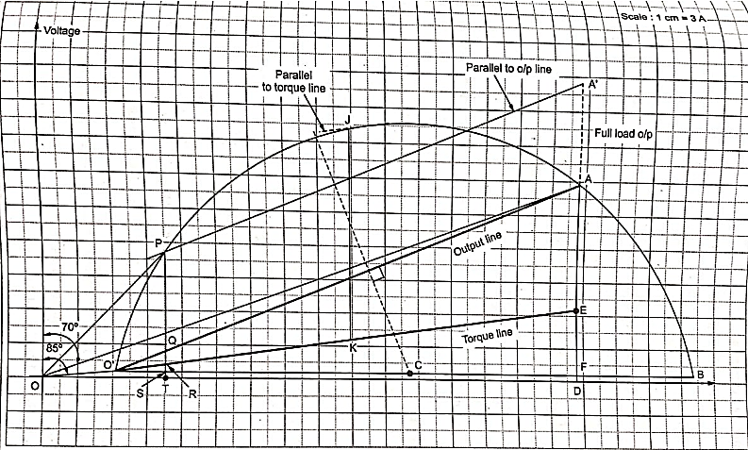

Slide 32
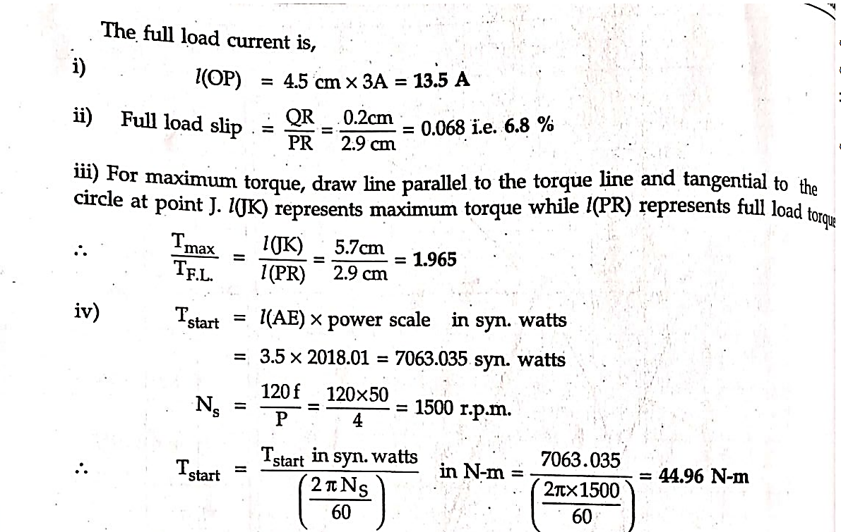

Slide 33
Crawling of Induction Motor
It has been observed that squirrel cage type induction motor has a tendency to run at very low speed compared to its synchronous speed, this phenomenon is known as crawling.
The resultant speed is nearly 1/7th of its synchronous speed.
Now the question arises why this happens? This action is due to the fact that harmonics fluxes produced in the gap of the stator winding of odd harmonics like 3rd, 5th, 7th etc.
These harmonics create additional torque fields in addition to the synchronous torque.

Slide 34
The torque produced by these harmonics rotates in the forward or backward direction at Ns/3, Ns/5, Ns/7 speed respectively.
Here we consider only 5th and 7th harmonics and rest are neglected.
The torque produced by the 5th harmonic rotates in the backward direction.
This torque produced by fifth harmonic which works as a braking action is small in quantity, so it can be neglected.
Now the seventh harmonic produces a forward rotating torque at synchronous speed Ns/7. Hence, the net forward torque is equal to the sum of the torque produced by 7th harmonic and fundamental torque.

Slide 35
The torque produced by 7th harmonic reaches its maximum positive value just below 1/7 of Ns and at this point slip is high.
At this stage motor does not reach up to its normal speed and continue to rotate at a speed which is much lower than its normal speed.
This causes crawling of the motor at just below 1/7 synchronous speed and creates the racket.
The other speed at which motor crawls is 1/13 of synchronous speed.

Slide 36
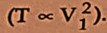
Torque proportional to the square of the applied voltage
Hence synchronous crawling may be observed which absent under rated voltage conditions.
Thus asynchronous harmonic torques cannot be avoided but can be reduced by proper choice of coil span and by skewing the stator and rotor slots.
The synchronous Harmonic torques can be totally eliminated by proper combination of stator and rotor slots.

Slide 37
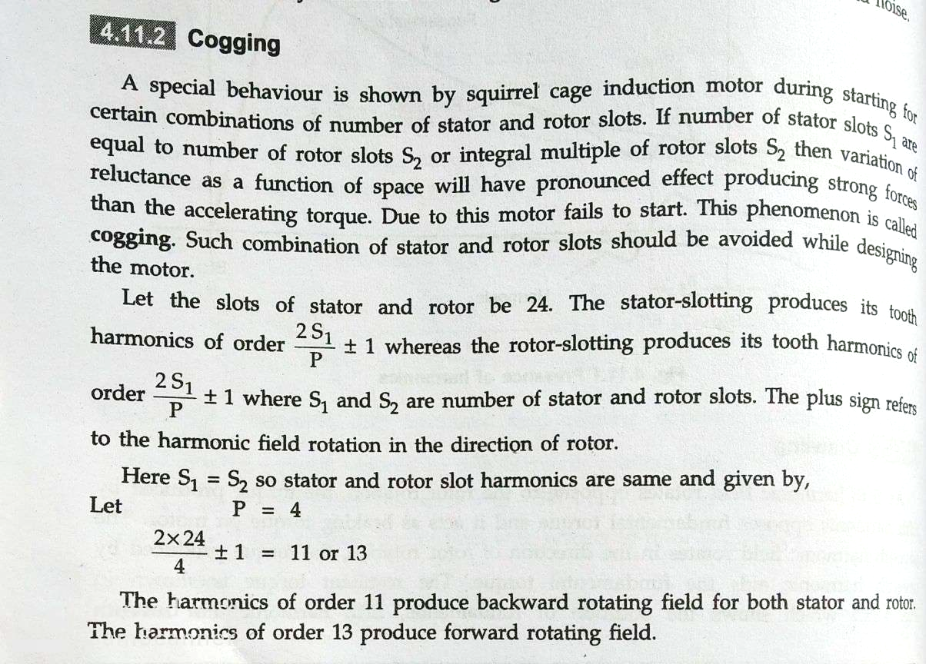

Slide 38
Cogging of Induction Motor
This characteristic of induction motor comes into picture when motor refuses to start at all.
Sometimes it happens because of low supply voltage.
But the main reason for starting problem in the motor is because of cogging in which the slots of the stator get locked up with the rotor slots.
As we know that there is series of slots in the stator and rotor of the induction motor.
When the slots of the rotor are equal in number with slots in the stator, they align themselves in such way that both face to each other and at this stage the reluctance of the magnetic path is minimum and motor refuse to start.
This characteristic of the induction motor is called cogging.

Slide 39
Apart from this, there is one more reason for cogging.
If the harmonic frequencies coincide with the slot frequency due to the harmonics present in the supply voltage then it causes torque modulation.
As a result, of it cogging occurs.
This characteristic is also known as magnetic teeth locking of the induction motor.

Slide 40
Methods to overcome Cogging
This problem can be easily solved by adopting several measures. These solutions are as follows:
The number of slots in rotor should not be equal to the number of slots in the stator.
Skewing of the rotor slots, that means the stack of the rotor is arranged in such a way that it angled with the axis of the rotation.

Slide 41
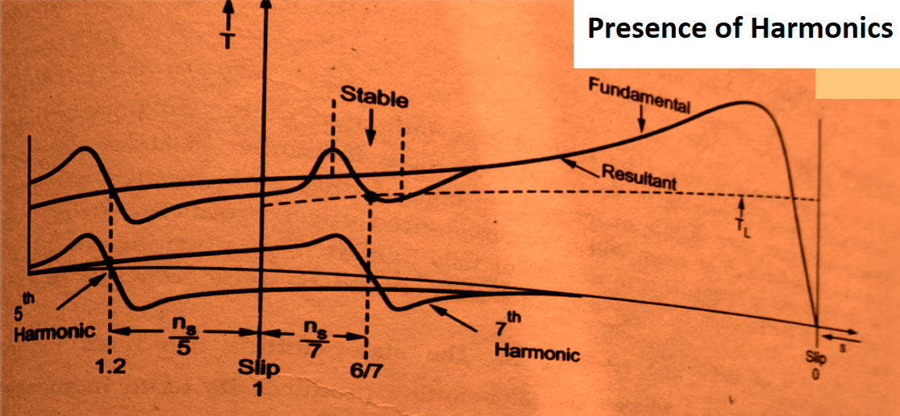

Slide 43
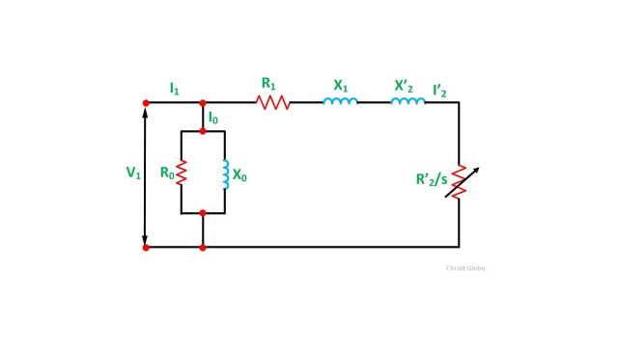
Equivalent circuit of 3 phase Induction motor

Slide 44
High torque rotors:
Double cage and Deep rotor bars.
Equivalent circuit and performance evaluation of Double cage induction motor.
Induction Motor working as induction Generator;
standalone operation &Grid connected operation.

Slide 45
But the thing is that squirrel cage induction motor has very low starting torque due to its rotor resistance of very low value. So to provide a higher value of rotor resistance in squirrel cage induction motor double bar double cage rotor is used in induction motor.
The motive is to provide higher value of rotor resistance in such a manner that the rotor with its higher valued resistance provides higher torque and more efficiency.

Slide 46
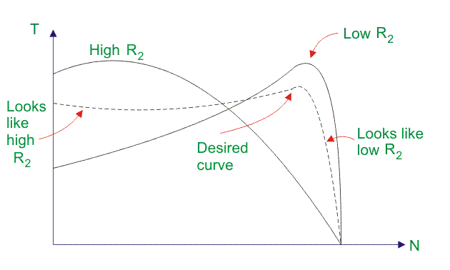

Slide 47
Why Starting Torque is Poor in Squirrel Cage Induction Motor?
The fixed resistance of the resistance cannot be varied in squirrel cage rotor as it is possible in slip ring induction motor.
he rotor of the squirrel cage induction motor is very low.
At the starting moment, the induced voltage in the rotor has same frequency as the frequency of the supply.
Hence the starting inductive reactance gets higher value at stand still condition.
The frequency of the rotor current gets same frequency as the supply frequency at standstill.

Slide 48
Now the case is that the rotor induced current in spite of having higher value lags the induced voltage at a large angle.
So this causes poor starting torque at the stand still condition.
This torque is only 1.5 times of the full load torque though the induced current is 5 to 7 times of the full load current.
Hence, this squirrel cage single bar single cage rotor is not being able to apply against high load.
We should go for deep bar double cage induction motor to get higher starting torque.

Slide 49
Construction of Deep Bar Double Cage Induction Motor
In deep bar double cage rotor bars are there in two layers.
Outer layer has the bars of small cross sections.
This outer winding has relatively large resistance.
The bars are shorted at the both ends.
The flux linkage is thus very less.
And hence inductance is very low.
Resistance in outer squirrel cage is relatively high.
Resistance to inductive reactance ration is high.

Slide 50
Inner layer has the bars of large cross section comparatively.
The resistance is very less.
But flux linkage is very high.
The bars are thoroughly buried in iron.
As flux linkage is high the inductance is also very high.
The resistance to inductive reactance ration is poor.

Slide 52
Operational Principle Construction of Deep Bar Double Cage Induction Motor
At the stand still condition the inner and outer side bars get induced with voltage and current with the same frequency of the supply.
Now the case is that the inductive reactance
(XL = 2πfL) is offered more in the deep bars or inner side bars due to skin effect of the alternating quantity i.e. voltage and current.
Hence the current tries to flow through the outer side rotor bars.

Slide 54
The outer side rotor offers more resistance but poor inductive reactance.
The ultimate resistance is somewhat higher than the single bar rotor resistance.
The higher valued rotor resistance results more torque to be developed at the starting.
When the speed of the rotor (N)of the deep bar double cage induction motor increases, the frequency (f)of the induced EMF and current in the rotor gets gradually decreased.
Hence the inductive reactance (XL) in the inner side bars or deep bars gets decreased and the current faces less inductive reactance and less resistance as a whole.
Now no need for more torque because the rotor already has arrived to its full speed with running torque.

Slide 55
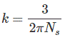
Where, R2 and X2 are the rotor resistance and inductive reactance at starting respectively, E2 is the rotor induced EMF and
Ns is the RPS speed of synchronous stator flux
S is the slip of the rotor speed.
The above speed-torque graph shows that the higher valued resistance offers higher torque at the stand still condition and the max torque will be achieved at higher valued slip.

Slide 56
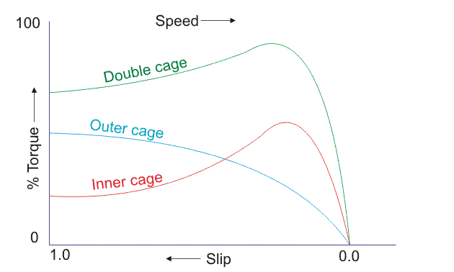
Speed Torque Characteristics of Deep Rotor IM

Slide 57
Each layer is short-circuited by the end rings.
The outer cage bars have a smaller cross-sectional area than the inner bars and are made of high resistivity materials like brass, aluminium, bronze, etc.
the bars of the inner cage are made of low resistance copper. Thus, the resistance of the outer cage is greater than the resistance of the inner cage.
There is a slit between the top and the bottom slots.
The slit increases linking the inner cage winding is much larger than that of the outer cage winding.
Thus, the inner winding has a greater self-inductance.

Slide 58
At starting, the voltage induced in the rotor is same as the supply frequency that is (f2 = f1).
Hence, the leakage reactance of the inner cage winding as compared to that of the outer cage winding is much larger.
The outer cage winding carries most of the starting current which offer low impedance to the flow of current.
The high resistance outer cage winding, therefore, develops a high starting torque.

Slide 59
As the rotor speed increases, the frequency of the rotor EMF (fr =sf) decreases.
At normal operating speed, the leakage reactance of both the windings become negligibly small.
The current in the rotor divides between the two cages and is governed by their resistances.
The resistance of the outer cage is about 5 to 6 times that of the inner cage.
Hence, the torque of the motor developed mainly by the low resistance inner cage and is developed under normal operating speed.

Slide 60
For the low starting torque requirements, an ordinary cage motor is used.
For higher torque requirements a deep bar cage motor is used.
A double cage motor is used for higher torques.
The slip ring construction is used for large size motors.
The starting torque and the starting periods is also large.

Slide 61
Comparison between Single Cage and Double Cage Motors
A double cage rotor has low starting current and high starting torque. Therefore, it is more suitable for direct on line starting.
Since effective rotor resistance of double cage motor is higher, there is larger rotor heating at the time of starting as compared to that of single cage rotor.
The high resistance of the outer cage increases the resistance of double cage motor. So full load copper losses are increased and efficiency is decreased.
The pull out torque of double cage motor is smaller than single cage motor.
The cost of double cage motor is about 20-30 % more than that of single cage motor og same rating.

Slide 62
Double Cage Rotor of an Induction Motor
A Double Cage Induction motor is that type of motor in which a double cage or two rotor windings or cages are used.
This arrangement is used for obtaining high starting torque at a low value of starting current.
The stator of a double cage rotor of an induction motor is same as that of a normal induction motor.
In the double cage rotor of an induction motor, there are two layers of the bars.
The figure of the Double cage induction motor is shown below.

Slide 63
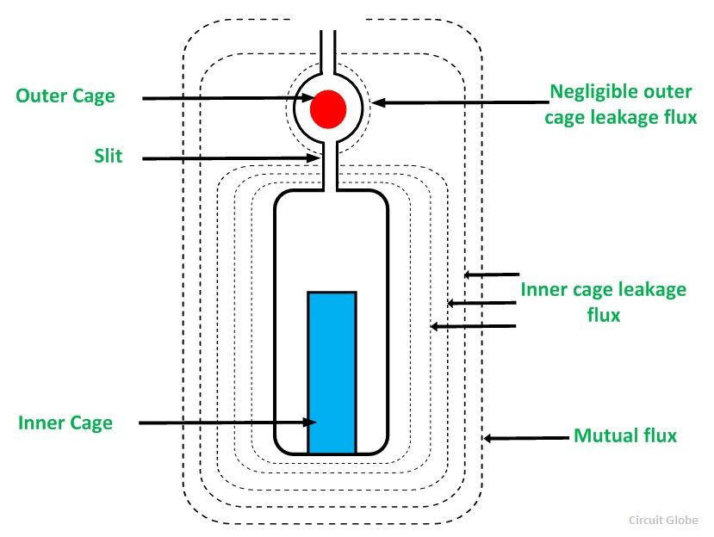
Double cage rotor

Slide 64
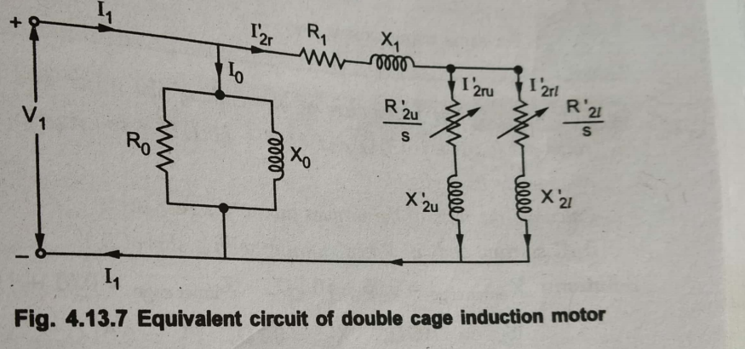

Slide 65
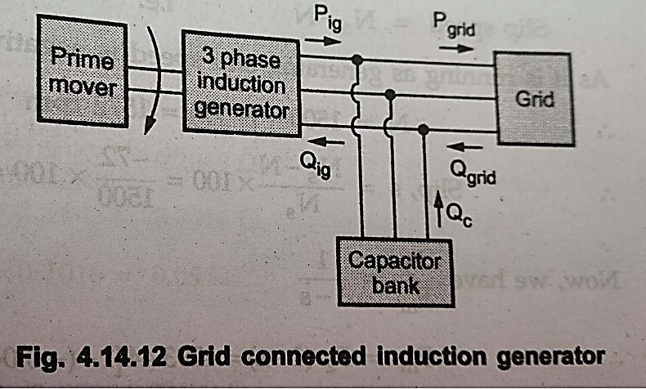
Grid connected induction Generator

Slide 66
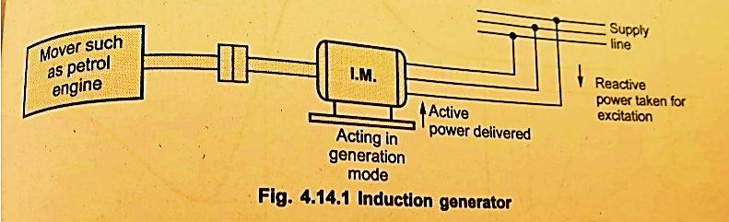
Grid connected induction Generator

Slide 67
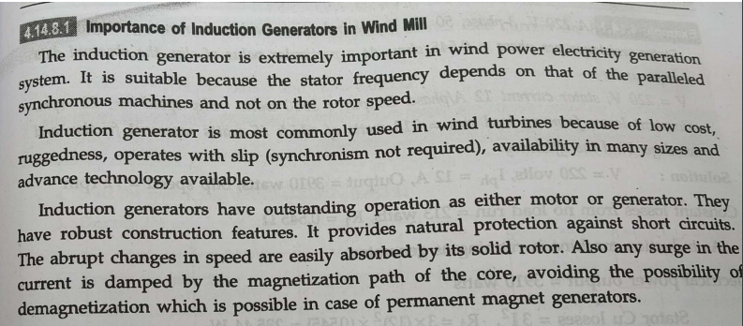

Slide 68
Induction generator-stand alone system

